Slide 1





BANK CUSTOMER COMPLAINTS CLASSIFICATION
PHS5_GROUP6_DSF-PT7
PROJECT PRESENTATION
NOVEMBER 2024

Slide 2





GROUP MEMBERS
Joseph Ngige - Group lead
Julian Kilyungi
Tabitha Kariuki
John Kul
Mary Musyoka
Norah Oluoch

Slide 3


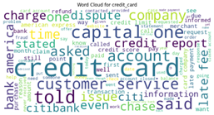

AREA OF INTERVENTION
CUSTOMER COMPLAINTS CLASSIFICATION
This project leverages Natural Language Processing (NLP) to streamline customer complaint classification, aiming to reduce the time and complexity customers face when submitting complaints.

Slide 4
EXECUTIVE SUMMARY
The project leverages on Natural Language Processing (NLP) to streamline customer complaint classification, reducing the time and complexity of logging complaints. By implementing a BERT-based model with an intuitive user interface, the solution categorizes complaints automatically, achieving strong performance metrics: a Macro F1-score of 0.85, Weighted F1-score of 0.89, and 89% accuracy. The deployed system, hosted on Hugging Face with a Streamlit UI, allows users to input their complaint text and receive immediate classification and notifications via Africastalking's SMS service. Future enhancements include integrating a feedback loop for continuous improvement, optimizing for specific complaint categories, and expanding notification channels to further enhance accuracy, adaptability, and customer experience.

Slide 5


PROJECT GOALS & OBJECTIVES
Minimize the time customers spend logging complaints by reducing the number of survey questions.
Create a simple user-friendly platform that allows customers to quickly submit their complaints or feedback.
1
Goals
2
Objectives
Train an NLP model to automatically classify consumer complaints into predefined categories based on their content.
Enhance the customer complaint logging experience by streamlining the complaint submission process.
Improve banks' responsiveness by providing faster, more accurate categorization of complaints.
1
3
2

Slide 6
BUSINESS UNDERSTANDING
Problem Statement:
Financial institution customers face frustration and delays when lodging complaints due to:
Complex navigation structures.
Inefficient chatbot interactions with redundant questions.
Lack of personalized complaint pathways.
Inadequate use of customer data, leading to repetitive information requests.
Key Stakeholders:
Customers: Need an intuitive interface for quick, hassle-free complaint submission and timely resolutions.
Customer Service Teams: Require efficient categorization tools and accurate data to resolve complaints swiftly and maintain high service quality.

Slide 7
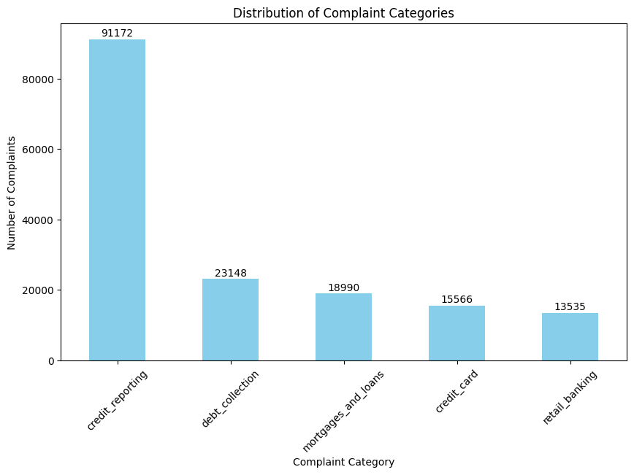
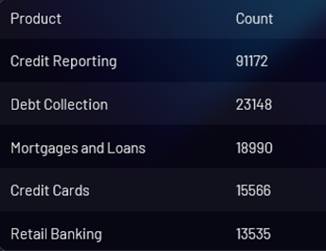
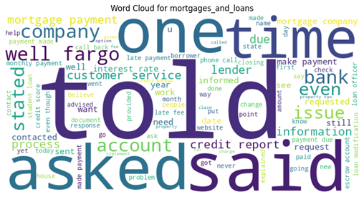
DATA UNDERSTANDING
Key Features of the Dataset:
162,400 records with varying narrative lengths.
Imbalanced distribution, with credit reporting dominating.
Significance:
This dataset is ideal for NLP model development, enabling automated classification and routing of consumer complaints to enhance efficiency.

Slide 8

MODEL TRAINING, EVALUATION, IMPROVEMENT & SELECTION
Data Exploration
Model Exploration
Preprocessing
Transformation
The project explored the CFPB's Consumer Complaints Dataset, analyzing data distribution, missing values, duplicates, and text length.
Preprocessing steps included lowercasing, special character handling, tokenization, stop word removal, and lemmatization.
The project applied TF-IDF transformation and MinMax Scaling to prepare the data for modeling.
Various machine learning algorithms were explored, including Multinomial Naive Bayes, SVM, Logistic Regression, Random Forest, and an ensemble model (ExtraTrees).
Model Deployment & Application
Model Selection
Model Improvement
deployment provides an efficient, user-focused platform for automatic complaint classification, reducing customer frustration and improving response times. The BERT model's strong language processing capabilities ensure accurate classifications, making this solution a responsive and effective complaint management tool.
The BERT model was selected for deployment due to its robust capabilities in handling natural language processing tasks.
The project further improved the model by tuning parameters, applying SMOTE, and experimenting with a transformer-based model (BERT).

Slide 9
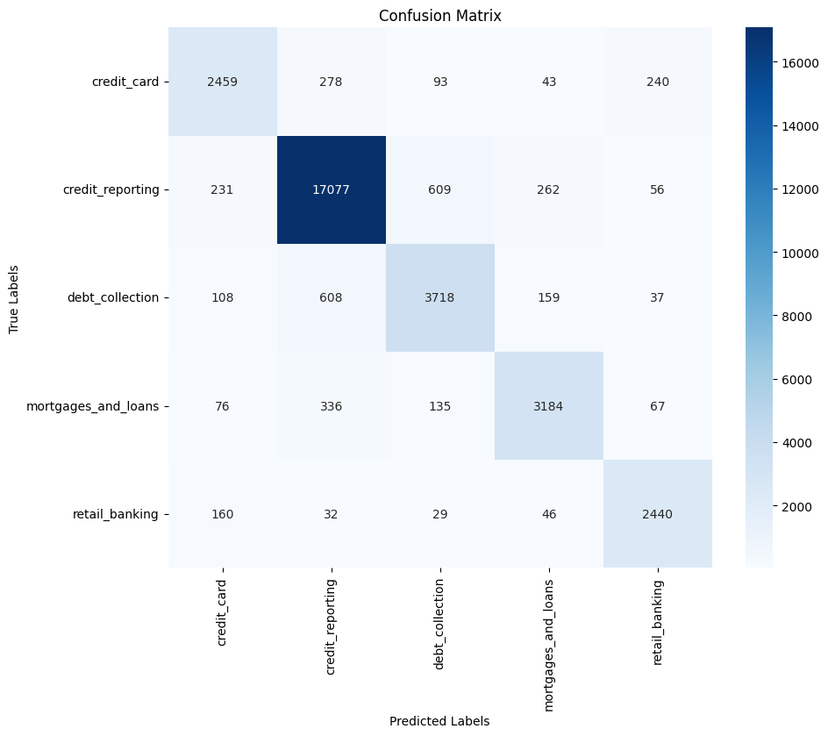
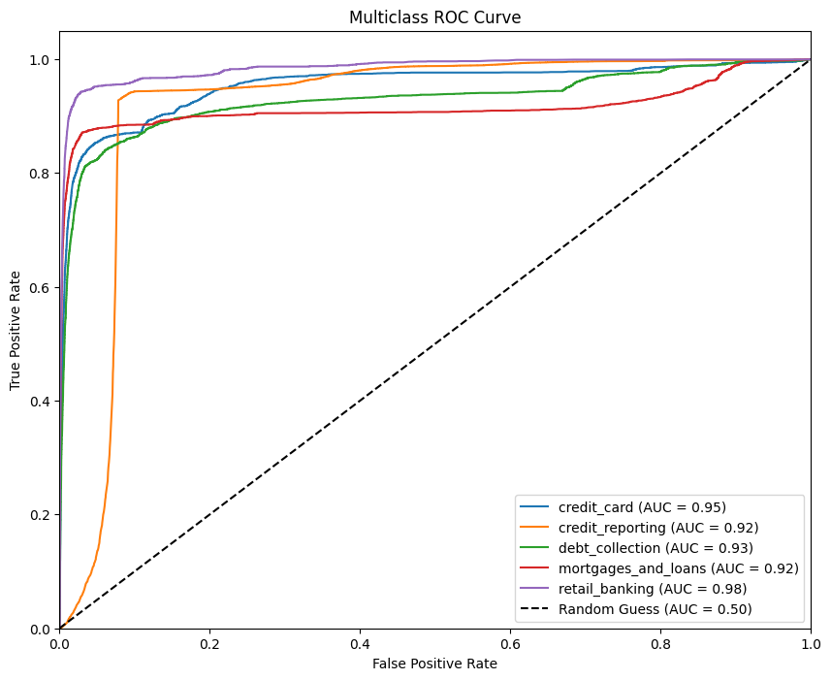
MODEL EVALUATION & IMPROVEMENT
Evaluation Metrics:
Accuracy: Overall correctness, though less reliable for imbalanced datasets.
Precision: Measures low false positive rates for each class.
Recall: Captures true positive rates, essential for identifying minority classes.
F1-score: Balances precision and recall, with Macro F1 as the primary focus for class equality and Weighted F1 for dataset-wide performance.
Additional Tools:
Confusion Matrix: Highlights areas of misclassification for each class.
AUC-ROC Curve: Aggregates classification performance across thresholds; higher values indicate better distinction.
Improvement Approaches:
Tuning Random Forest: Parameter adjustments to boost performance.
SMOTE Application: Balances class distribution for fairer training.
Transformer-Based Model (BERT): Benchmarked performance on text classification

Slide 10
MODEL SELECTION
Selected Model for Deployment: BERT transformer Model
Key Reasons:
Natural Language Suitability: Captures contextual meanings and details, critical for classifying nuanced customer complaints.
Generalization Potential: Pretrained on large corpora, enabling adaptability to unseen data and evolving language trends.
Challenges:
Computational Demands: Requires significant resources, manageable with adequate infrastructure.
Interpretability: Deep architecture complicates explainability compared to simpler models like ExtraTrees.
Despite its challenges, BERT's ability to handle complex language structures provides a strategic advantage in accurately classifying customer complaints, ensuring better long-term performance and hence recommended for deployment.

Slide 11
DEPLOYMENT AND APPLICATION
To simplify the customer complaint process, we deployed an efficient, user-friendly platform combining advanced NLP with real-time notifications.
Features:
Streamlit-Based Interface:
Enables customers to input complaints with phone and account details.
Simplifies submission by categorizing complaints automatically via the BERT model.
Real-Time Classification:
BERT processes complaints to determine the appropriate category instantly.
Automated Notifications:
Integrated with Africastalking’s bulk SMS API for instant notifications:
Complaint details sent to the designated customer support team.
A copy sent to the customer for their record.
SMS chosen over email to avoid delivery delays.
Hugging Face Deployment:
Accessible via a shared link, enabling seamless customer interactions.
Challenges and Future Work:
Limitations:
SMS support restricted to Airtel and Telkom numbers due to Safaricom restrictions.
Future Work:
Implement a feedback loop for continuous model improvement.
Expand notification support to other networks and revisit email notifications.

Slide 12
CONCLUSION & RECOMMENDATIONS
Conclusion:
The deployment of the BERT-based classification system successfully automates the categorization of bank customer complaints. With a weighted F1-score of 0.89 and a macro F1-score of 0.85, the model demonstrates robust performance and reliability across complaint categories. Integrated into a user-friendly Streamlit interface and deployed on Hugging Face, the solution simplifies the submission process, minimizes customer friction, and ensures timely routing of complaints to appropriate support teams via SMS.
Impact:
Streamlined complaint submission enhances customer satisfaction.
Automated classification improves response times and operational efficiency.
Limitations:
Variability in model performance for certain complaint categories.
SMS is restricted to Airtel and Telkom networks due to Safaricom's limitations.
Recommendations:
Implement a Feedback Loop: Continuously retrain the model with new complaint data for enhanced accuracy.
Expand Notification Options: Address Safaricom restrictions and revisit email notifications for broader reach.
Optimize Model Performance: Use additional tuning and data augmentation for improved accuracy on specific categories.

Slide 13

Q&As
THANK YOU
Presented by :
Phs5_Group6_dsf-pt7
Authors: Mary Musyoka, Julian Kilyungi, Tabitha Kariuki, John Kul, Norah Oluoch and Joseph Ngige.

